Slide 1
Do It For Yourself: How To Make It As a Solo Drupal Shop
Adam Varn
adamvarn@gmail.com
@hotsaucedesign

Slide 2
Who is this guy?
From Tampa
Built first site in 1997. Started with Drupal in 2009
Front End Developer/Site Builder
Happily married and proud owner of 3 cats

Slide 3
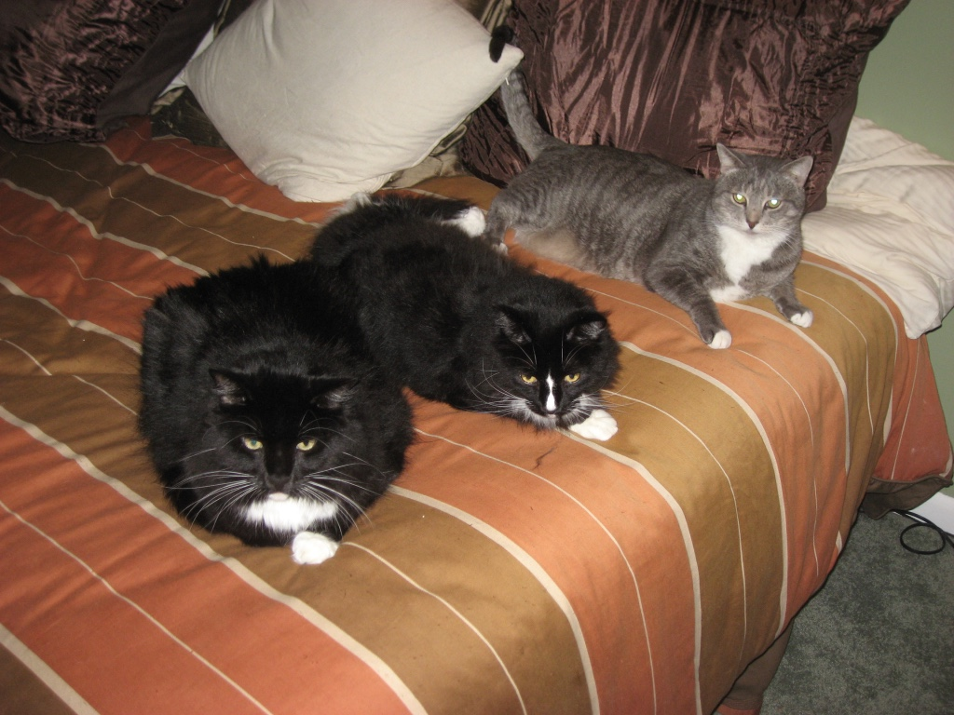
Who is this guy?
Everyone say awww...

Slide 4
Who is this guy?
And an almost 5 year old...

Slide 5
Developer Background
1997 – 2001: HTML By Hand

Slide 6
Remember spacer.gif & table layouts?

Slide 7
Developer Background
2001 – 2004: HTML & Cold Fusion

Slide 8
Yes, Cold Fusion is still a thing.

Slide 9
Developer Background
2005 – 2008: Worked in Retail.
Also sold blinds.

Slide 10
Don’t worry, this is going somewhere.

Slide 11
Developer Background
2008 – 2009: Built WYSIWYG sites. For a phone book company.

Slide 12
You know, those things you recycle every year.

Slide 13
Developer Background
2009 - Now: Drupal Front End Dev

Slide 14
Starting with Drupal
WTF is Drupal?
Began as a designer, learned as I went.
Took over from RightSprocket.
Launched Hot Sauce Design & Development in 2010.

Slide 15
Setting Up Shop
Know your skill set.
Dot your i’s and cross your t’s.
Set a routine, and stick with it.
Organize thyself.

Slide 16
Setting Up Shop
Know your skill set.
Dot your i’s and cross your t’s.
Set a routine, and stick with it.
Organize thyself.

Slide 17
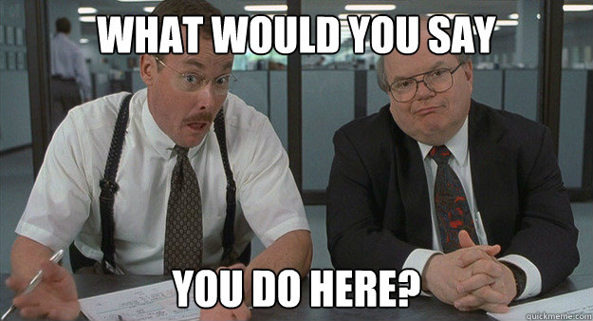
Know Your Skill Set
Are you front end? Site builder? Programmer?
Understand your own limitations.
Use your own experiences for your benefit.
Be prepared to work.

Slide 18
Setting Up Shop
Know your skill set.
Dot your i’s and cross your t’s.
Set a routine, and stick with it.
Organize thyself.

Slide 19
Dot your i’s and cross your t’s
Build a web presence for yourself.
Take care of yourself and your family.
Get things straight with the tax man.

Slide 20
Don’t worry, you won’t have to release your tax returns either.

Slide 21
Setting Up Shop
Know your skill set.
Dot your i’s and cross your t’s.
Set a routine, and stick with it.
Organize thyself.

Slide 22
Set a routine, and stick with it.
Keep consistent hours.
Be prompt and professional.
Take advantage of working for yourself.

Slide 23
There are no internet emergencies.

Slide 24
Setting Up Shop
Know your skill set.
Dot your i’s and cross your t’s.
Set a routine, and stick with it.
Organize thyself.

Slide 25
Organize thyself.
Keep track of everything!
Seek professional help.
Keep learning.

Slide 26
Keeping The Lights On
Know what to charge.
What clients to strive for (or not).
Don’t over promise and under deliver.
Accept rejection.

Slide 27
Keeping The Lights On
Know what to charge.
What clients to strive for (or not).
Don’t over promise and under deliver.
Accept rejection.

Slide 28
Know What To Charge
Drupal is an in-demand skill.
Sell yourself, as well as Drupal.
Be flexible.
Use the margins where you can.

Slide 29
Keeping The Lights On
Know what to charge.
What clients to strive for (or not).
Don’t over promise and under deliver.
Accept rejection.

Slide 30
What Clients To Strive For
Cheapest is as cheapest does.
Find a niche, if you can.
Ask for referrals.
Network outside your comfort zone.

Slide 31
Keeping The Lights On
Know what to charge.
What clients to strive for (or not).
Don’t over promise and under deliver.
Accept rejection.

Slide 32
Don’t Over Promise & Under Deliver
Be realistic with time frames.
Keep clients in the know.
Look for ways to over achieve without killing yourself.
Don’t be afraid to say “NO”.

Slide 33
Keeping The Lights On
Know what to charge.
What clients to strive for (or not).
Don’t over promise and under deliver.
Accept rejection.

Slide 34
Accept Rejection
You won’t get every job.
Clients will leave.
It’s not personal.
If it’s no longer fun, try to fix that.

Slide 35
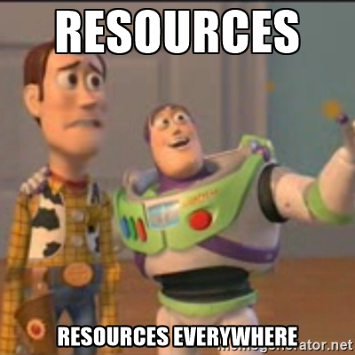
To Infinity & Beyond!
Know what you don’t know.
Contractor employment is your friend.
We are all trying to make a buck.
None of us know what we are really doing.

Slide 36
To Infinity & Beyond!
Know what you don’t know.
Contractor employment is your friend.
We are all trying to make a buck.
None of us know what we are really doing.

Slide 37
Know What You Don’t Know
Seek out help at meetups, or job boards
Delegate all the duties!
Ask questions. Then ask more questions.
Empathize, but be firm. You speak for your client.

Slide 38
To Infinity & Beyond!
Know what you don’t know.
Contractor employment is your friend.
We are all trying to make a buck.
None of us know what we are really doing.

Slide 39
Contractor Employ. Is Your Friend
Keeps you busy. And money in the bank.
Great for clients, and for you.
Clarify boundaries and expectations.
If it doesn’t work, walk away.

Slide 40
To Infinity & Beyond!
Know what you don’t know.
Contractor employment is your friend.
We are all trying to make a buck.
None of us know what we are really doing.

Slide 41
We Are All Trying To Make A Buck
Pay your bills.
Re-evaluate your setup every 6 months.
No one works “for exposure”.

Slide 42
To Infinity & Beyond!
Know what you don’t know.
Contractor employment is your friend.
We are all trying to make a buck.
None of us know what we are really doing.

Slide 43
None of us know what we are doing
We’ve all made mistakes.
Plan as best as you can.
Down time isn’t always bad.

Slide 44
Geez, will he get to the Q&A already?

Slide 45
Contact Info
Adam Varn
adamvarn@gmail.com
Twitter: @hotsaucedesign
www.hotsaucedesign.com

